Slide 1
Chapter 3
Structure of a C Program
Objectives
❏ To be able to list and describe the six expression categories
❏ To understand the rules of precedence and associativity in
evaluating expressions
❏ To understand the result of side effects in expression evaluation
❏ To be able to predict the results when an expression is evaluated
❏ To understand implicit and explicit type conversion
❏ To understand and use the first four statement types: null, expression, return, and compound

Slide 2
3-1 Expressions
An expression is a formula in which operands are linked to each other by the use of operators to compute a value.
An expression is a sequence of operands and operators that reduces to a single value. Expressions can be simple or complex.
-An operator is a syntactical token that requires an action be taken.
-An operand is an object on which an operation is performed; it receives an operator’s action.
-An operand can be a function reference, a variable, an array element or a constant.
Topics discussed in this section:
Primary Expressions
Postfix Expressions
Prefix Expressions
Unary Expressions
Binary Expressions

Slide 3
Note
An expression always reduces to a single value.

Slide 4
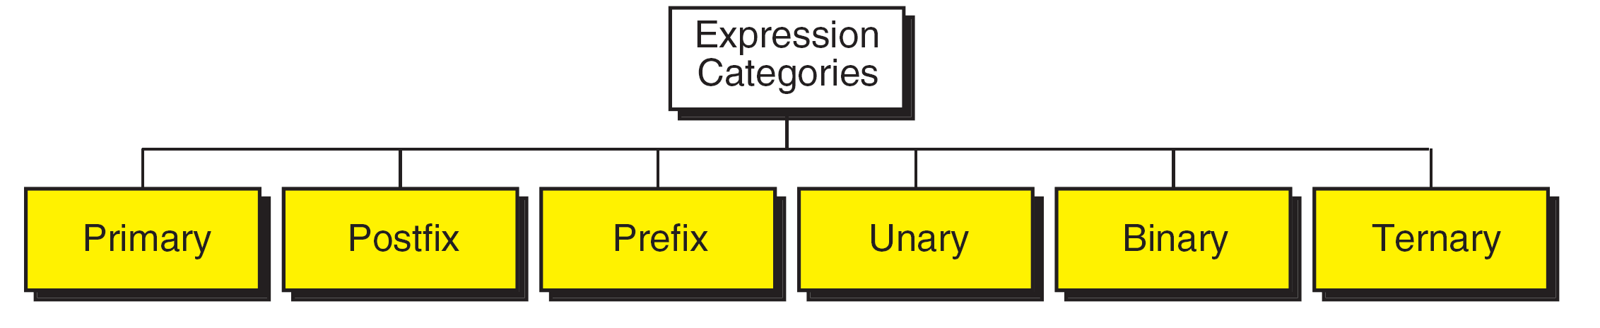
FIGURE 3-1 Expression Categories

Slide 5
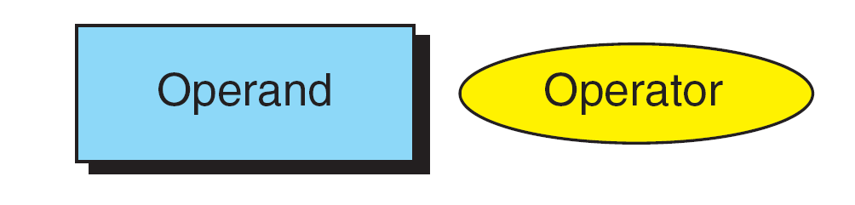
FIGURE 3-2 Postfix Expressions

Slide 6
Note
(a++) has the same effect as (a = a + 1)

Slide 7
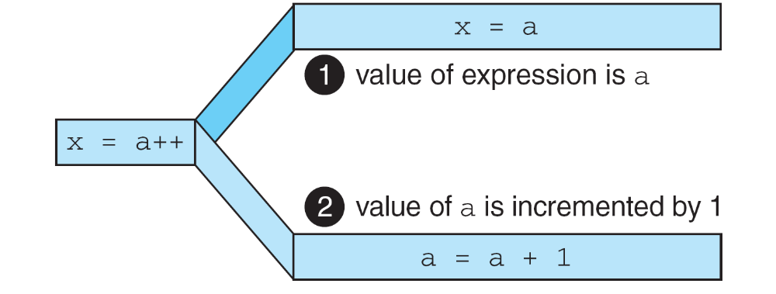
FIGURE 3-3 Result of Postfix a++

Slide 8
Note
The operand in a postfix expression must be a variable.

Slide 9
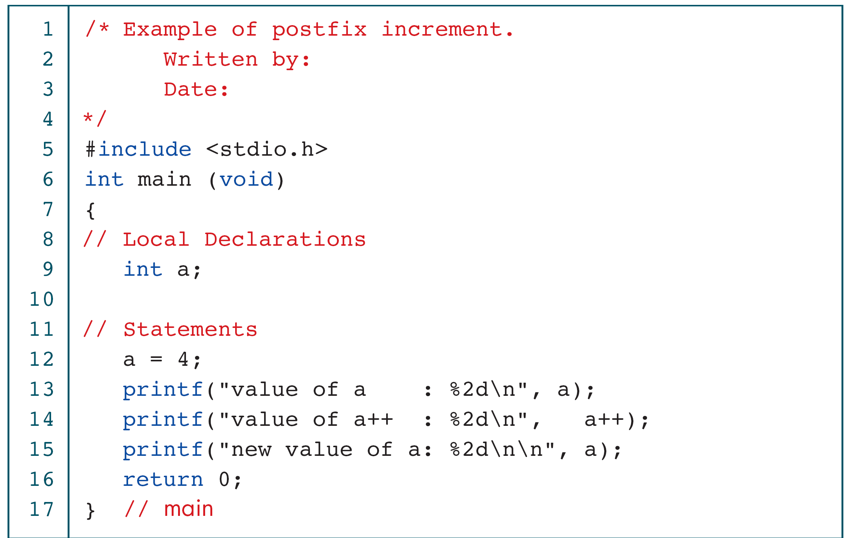
PROGRAM 3-1
Demonstrate Postfix Increment

Slide 10
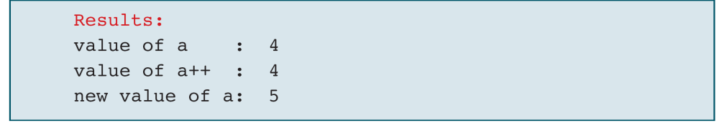
PROGRAM 3-1
Demonstrate Postfix Increment (continued)

Slide 11
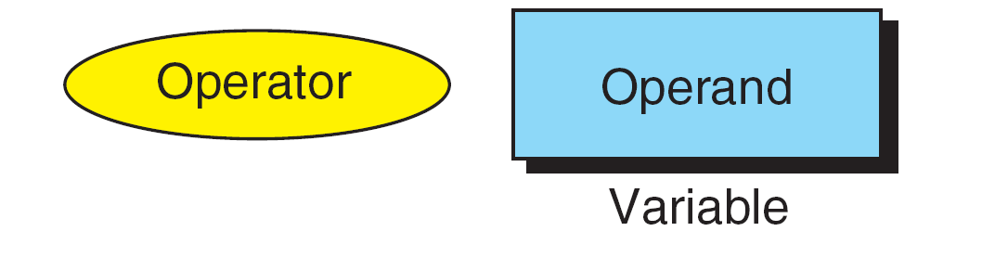
FIGURE 3-4 Prefix Expression

Slide 12
Note
The operand of a prefix expression must be a variable.

Slide 13
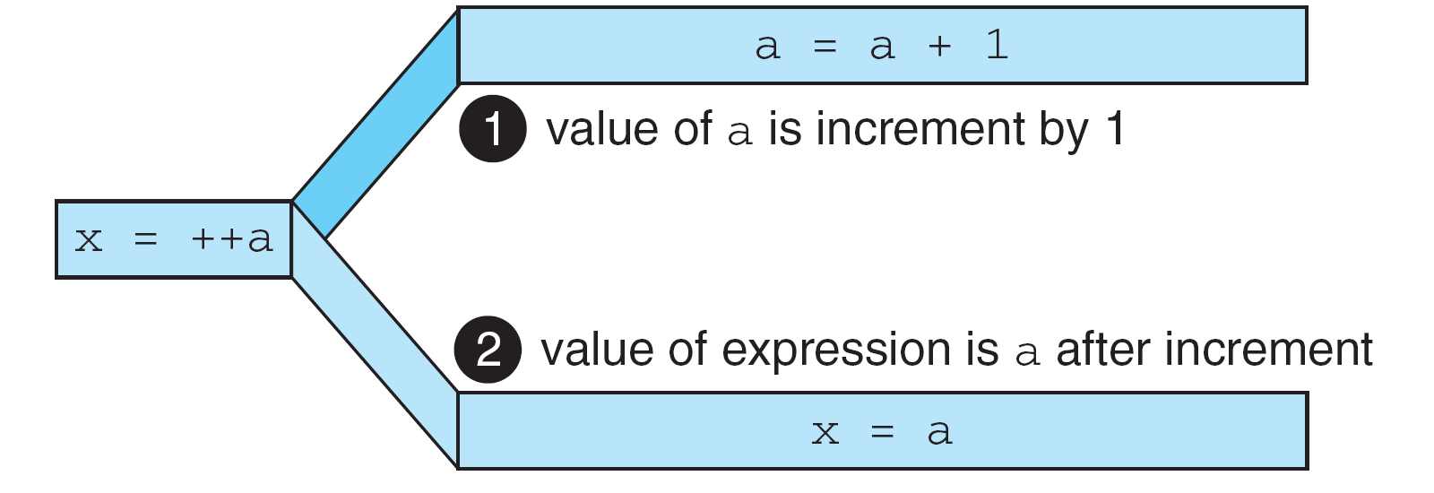
FIGURE 3-5 Result of Prefix ++a

Slide 14
Note
(++a) has the same effect as (a = a + 1)

Slide 15
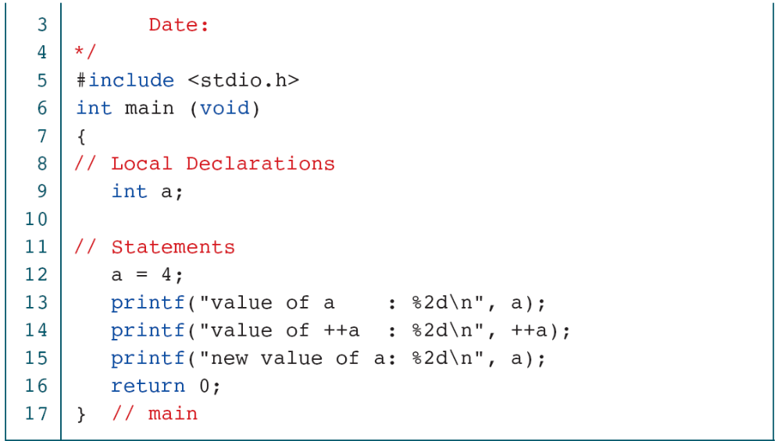
PROGRAM 3-2
Demonstrate Prefix Increment

Slide 16
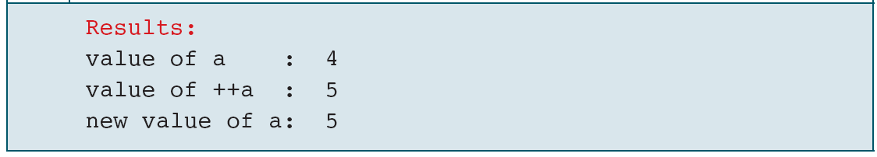
PROGRAM 3-2
Demonstrate Prefix Increment (continued)

Slide 17
Note
If ++ is after the operand, as in a++, the increment takes place after the expression is evaluated.
If ++ is before the operand, as in ++a, the increment
takes place before the expression is evaluated.

Slide 18

-A unary operator is an operator used to operate on a single operand to return a new value.
-In other words, it is an operator that updates the value of an operand or expression's value by using the appropriate unary operators. 1-10, ++,--,,,,a=10, a--, a, a<1
-In Unary Operator, operators have equal priority from right to left side associativity.
Unary Minus (-)
Unary Plus (+)
Increment (++)
Decrement (--)
Logical Negation (!)
FIGURE 3-6 Unary Expressions

Slide 19
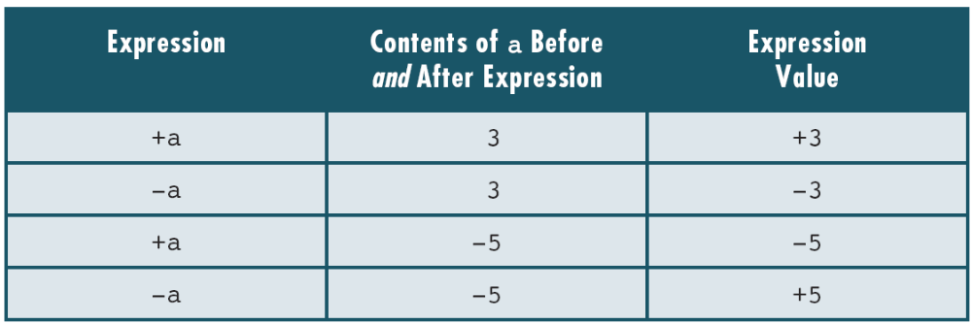
Table 3-1
Examples of Unary Plus And Minus Expressions

Slide 20
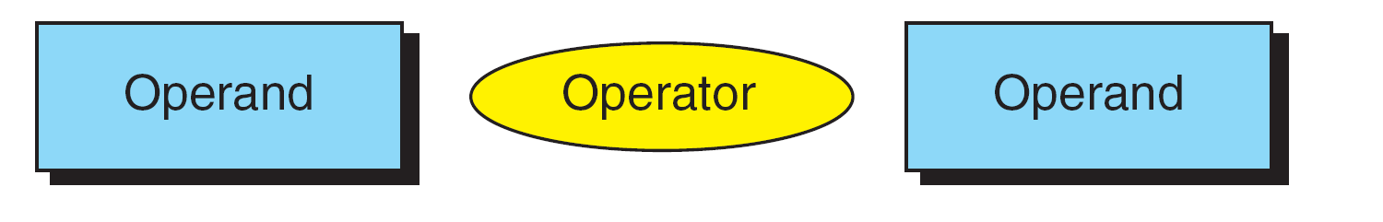
Bitwise operators are those binary operators in C that are used to manipulate bits in different ways. They are equivalent to how we use mathematical operations like (+, -, /, *) among numbers, similarly, we use bitwise operators like (||, &, ^, <<, >>, ~) among bits.
For example, a common binary expression would be a + b—the addition operator (+) surrounded by two operands. The binary operators are further subdivided into arithmetic, relational, logical, and assignment operators.
FIGURE 3-7 Binary Expressions

Slide 21
Note
Both operands of the modulo operator (%) must
be integral types.

Slide 22
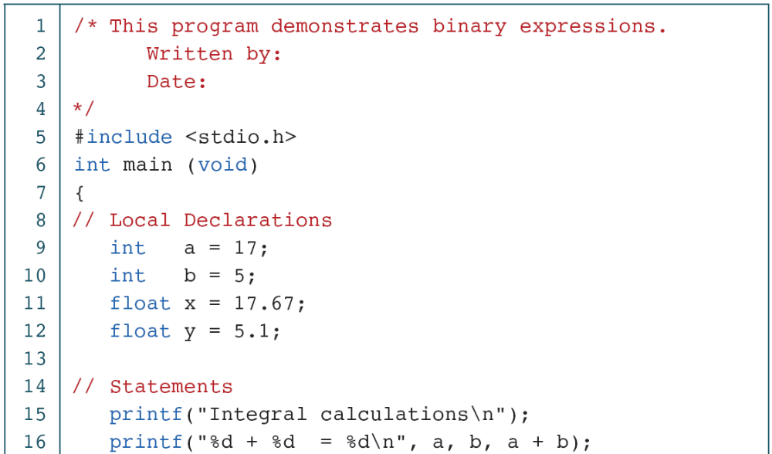
PROGRAM 3-3
Binary Expressions

Slide 23
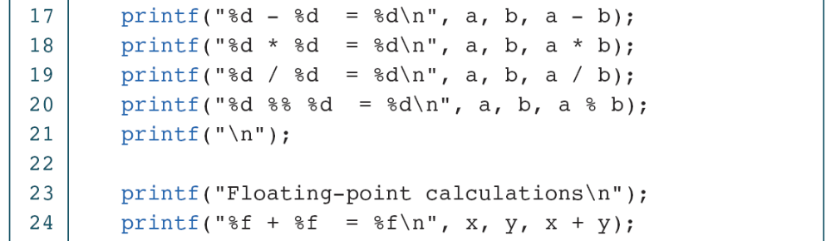
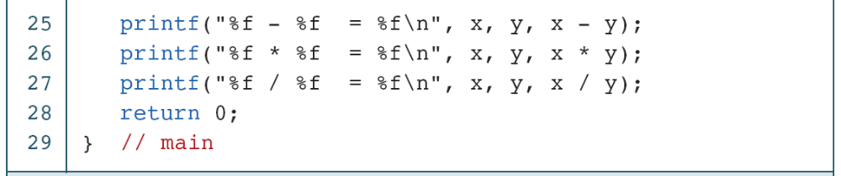
PROGRAM 3-3
Binary Expressions (continued)

Slide 24
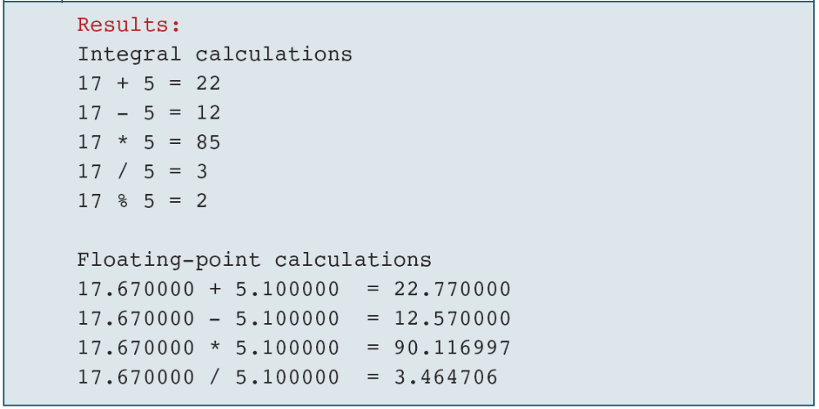
PROGRAM 3-3
Binary Expressions (continued)

Slide 25
Note
The left operand in an assignment expression must be a single variable.

Slide 26
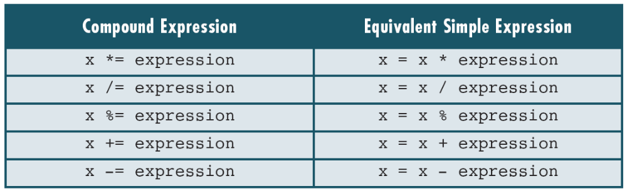
Table 3-2
Expansion of Compound Expressions

Slide 27
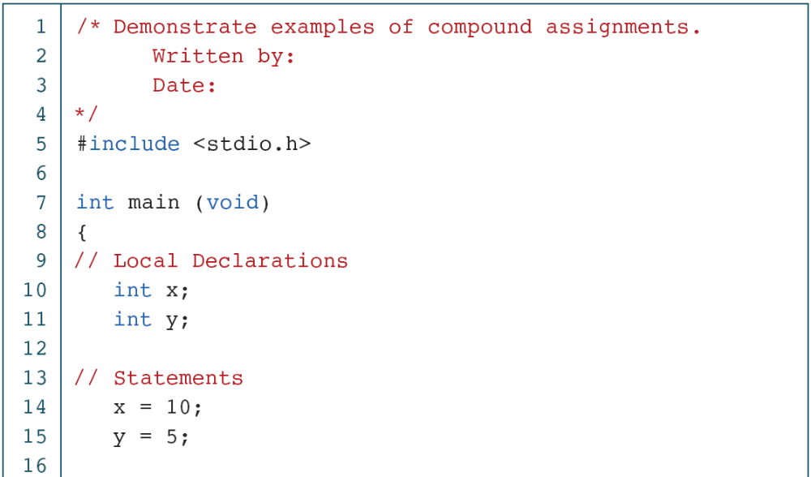
PROGRAM 3-4
Demonstration of Compound Assignments

Slide 28
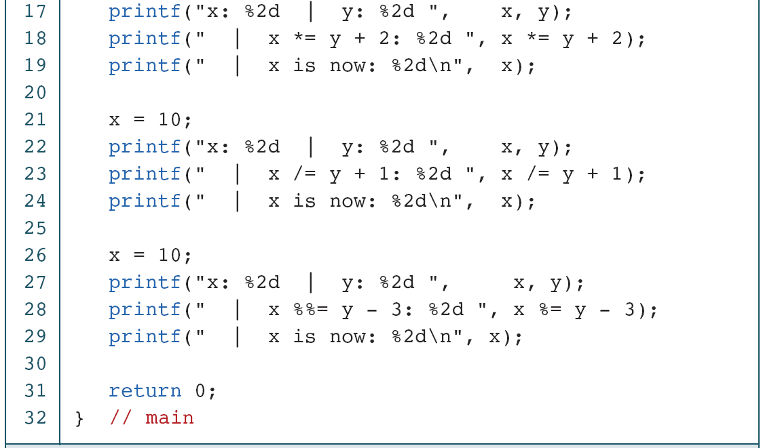
PROGRAM 3-4
Demonstration of Compound Assignments

Slide 29
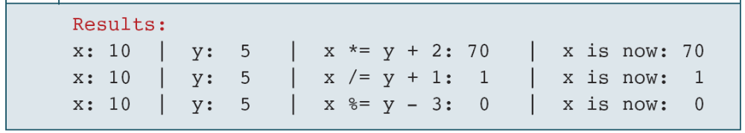
PROGRAM 3-4
Demonstration of Compound Assignments

Slide 30
3-2 Precedence and Associativity
Precedence is used to determine the order in which different operators in a complex expression are evaluated. Associativity is used to determine the order in which operators with the same precedence are evaluated in a complex expression. BODMAS/PEMDAS
#include <math.h>
Topics discussed in this section:
Precedence
Associativity

Slide 31
PROGRAM 3-5
Precedence

Slide 32
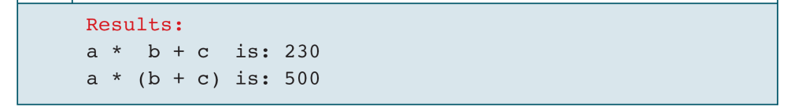
PROGRAM 3-5
Precedence

Slide 33
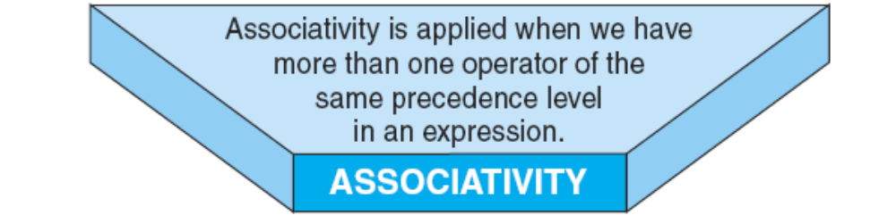

Slide 34
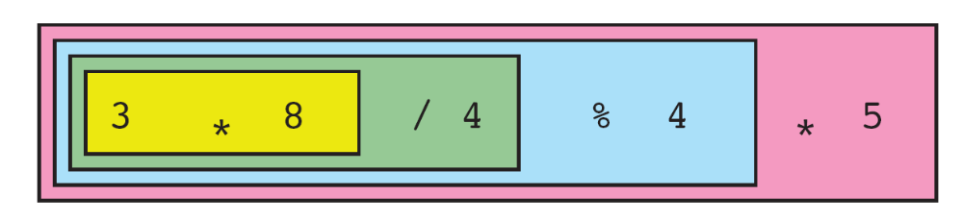
FIGURE 3-8 Left-to-Right Associativity

Slide 35
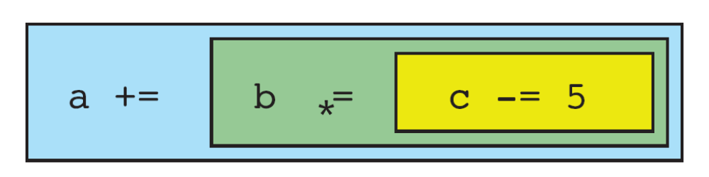
FIGURE 3-9 Right-to-Left Associativity

